Slide 1
WAD2 Group Project
Team 10-D

Slide 2
Project Overview
Users will be able to view albums
Authenticated users will be able to rate, comment on and upload albums
The home page will show top rated albums, albums uploaded that day, and a search feature for users/albums
A “follow” system- users will be able to follow other users, and albums they rate will show in the home page

Slide 3

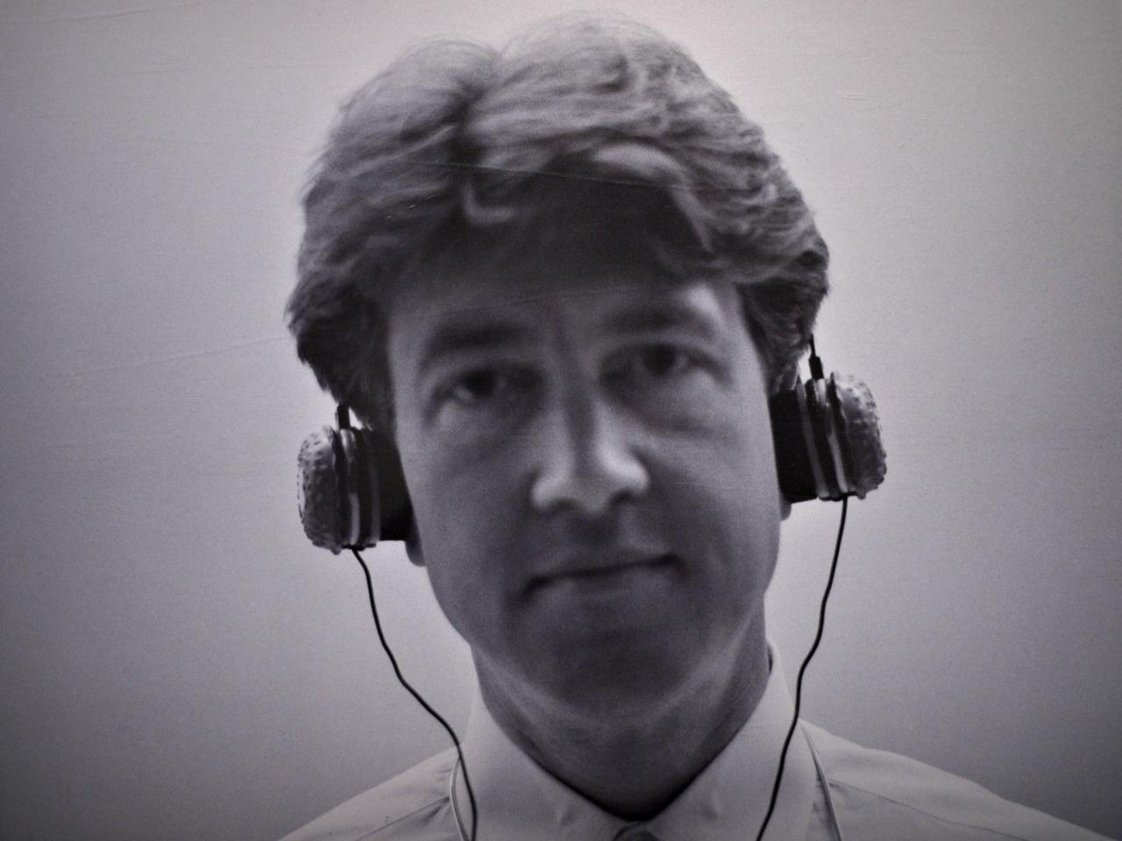
User Personas
Casual Listener Derek:
Description: Derek loves listening to music, but he doesn't have time to search deeply for new releases.
Goal: He wants to find new albums, and quickly rate and read comments from other users.
Tasks:
Convenient search for albums, sort them by popularity/dates.
Keep track of what his friends like.

Slide 4
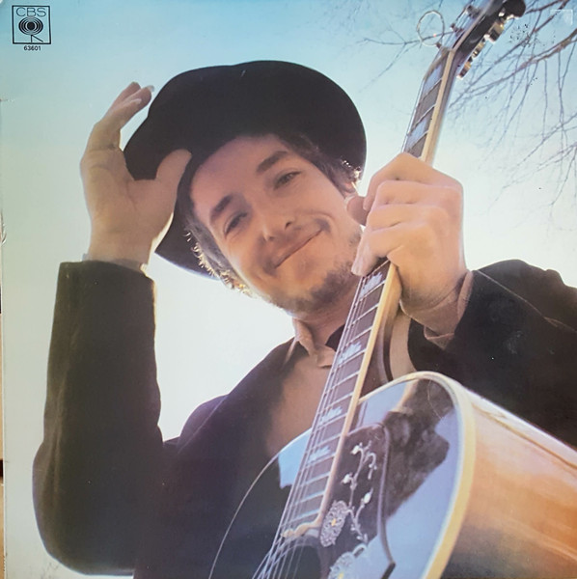
User Personas
Content Creator Evan:
Description: Evan is an aspiring musician, who records his own tracks and wants to share them with the community.
Goal: He wants to upload his albums, and get feedback and a fan base.
Tasks:
Easy upload albums and covers.
Ability to track statistics (number of likes, views and comments).
Get fan feedback from comments

Slide 5

User Personas
Music Critic Jared:
Description: Jared is an experienced music lover, he runs a blog and loves to give detailed reviews of music by using the comment system.
Goal: He wants to search for rare/interesting albums, and comment on them in detail.
Tasks:
Ability to find albums by genre and other metadata.
Write detailed comments for each album.

Slide 6
Project Specification
Specification | Description
Registration and authorisation | The user can create an account using a login and password. Authenticated users have access to rate, comment and upload album features.
User profile | Display basic information: username, registration date, uploaded albums, etc. Ability to change password and some settings.
Albums uploading | Fields when uploading: Album title, Cover, Genre, Release Date (defaults to current date) and Description (optional). Tracking upload date, views, score.
Like/dislike system | Each album can be rated out of 5 stars The average rating is displayed next to each album.
Comment system | Ability to leave text comments and scores under the album. Display a list of all comments in chronological order.
The mechanics of “Followers” | Users can follow each other. The Home page displays the latest ratings from people you follow.
Search and sort | Full text search by album title and username. Filter by score, upload date, popularity.
Views | Each time you open an album page the view counter increases. Using cookies or sessions to avoid “cheated” views from the same user in a short period of time.

Slide 7
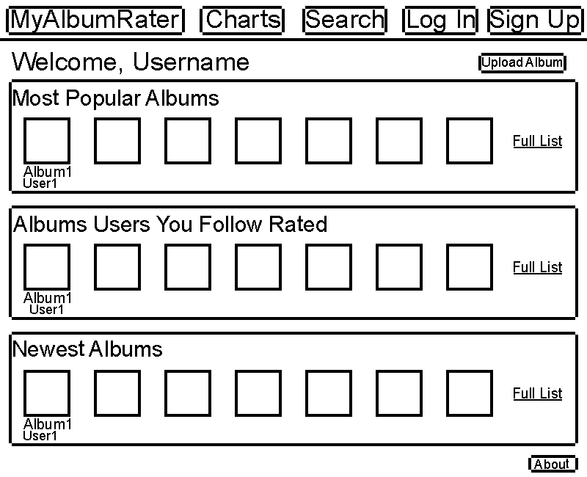
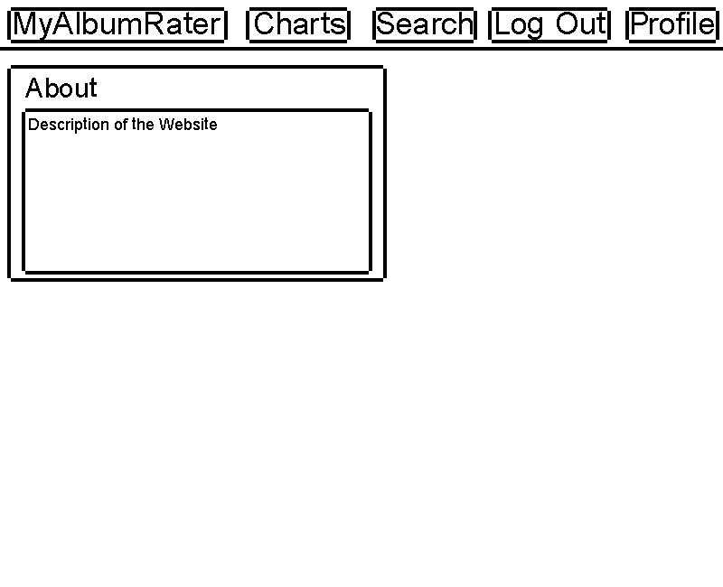
Wireframes – Home, About pages

Slide 8
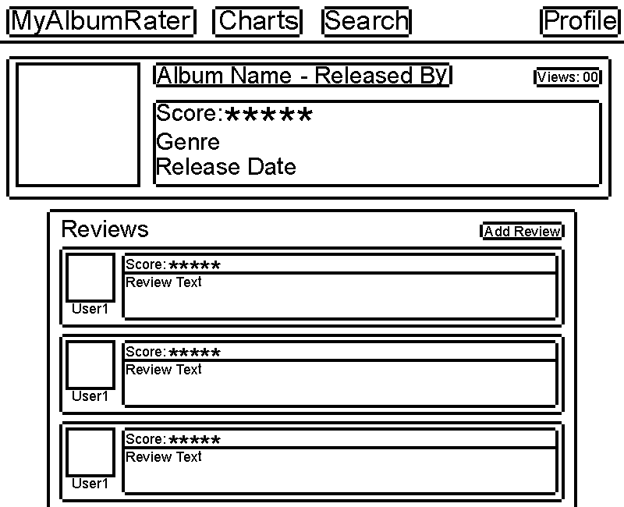
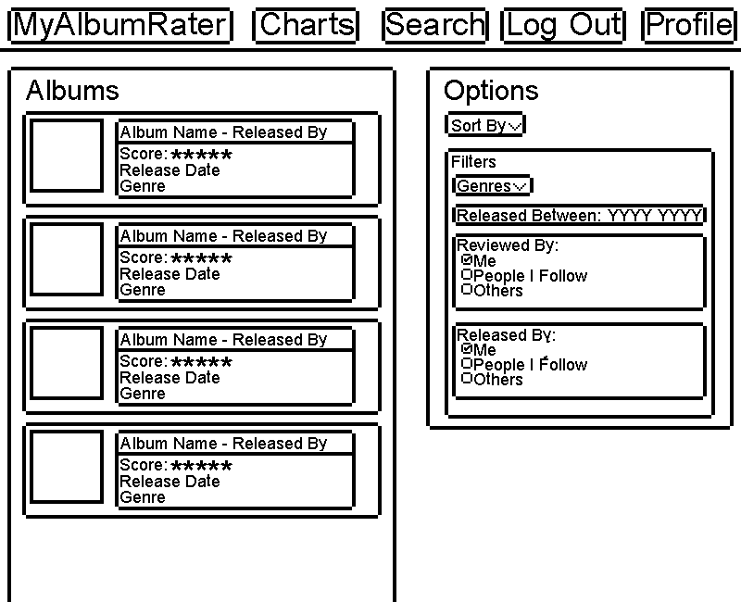
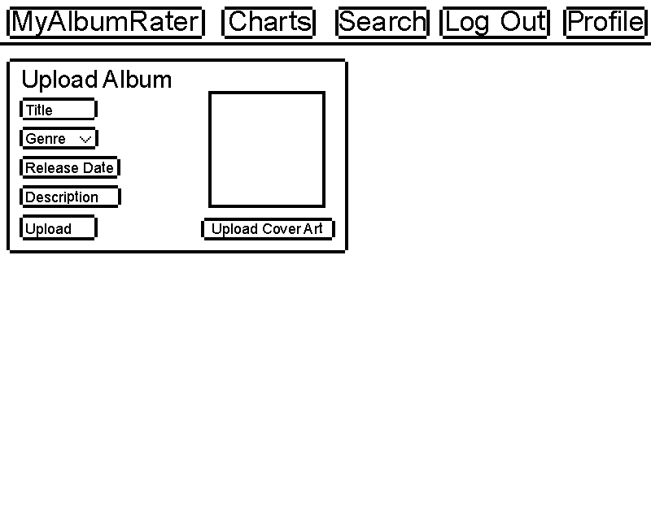
Wireframes – Album, search, upload album pages

Slide 9
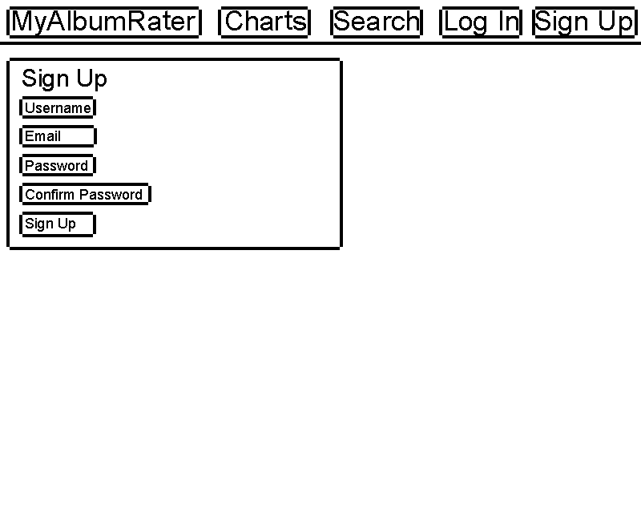
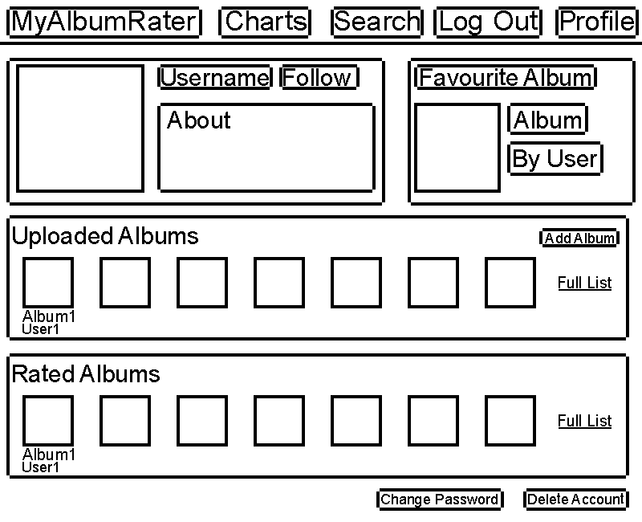
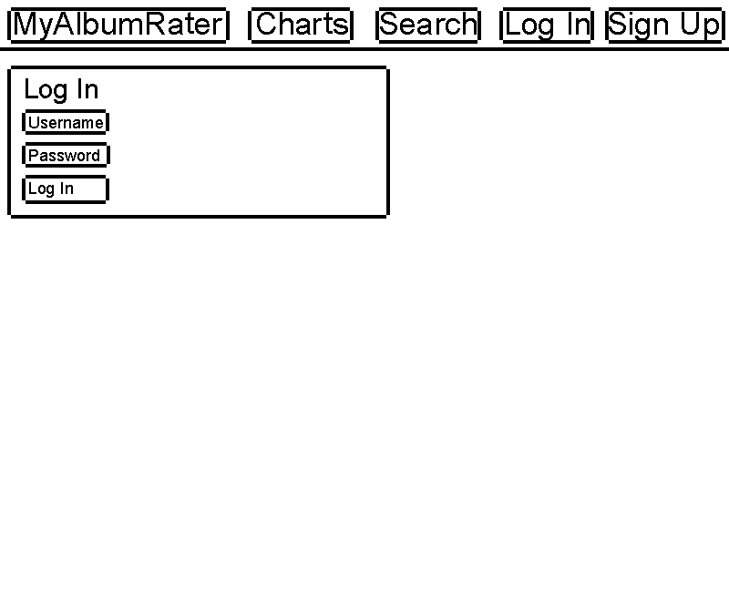
Wireframes – User page, log in, sign up

Slide 10
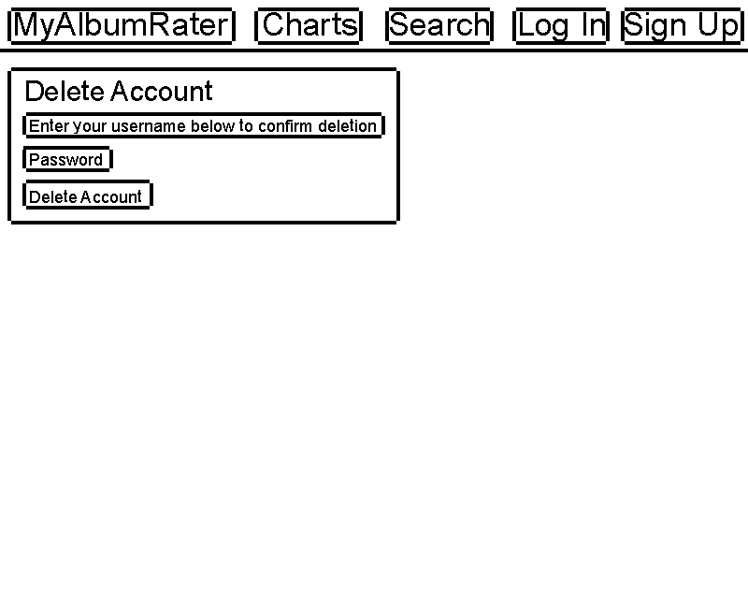
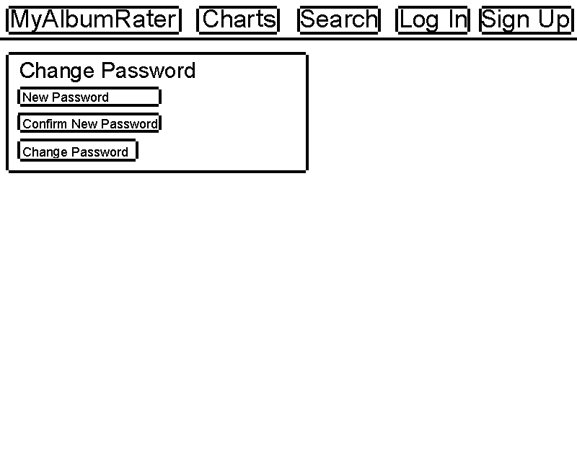
Wireframes – Delete account, change password

Slide 11




System Architecture Diagram
Model
URL
View
User
Web browser
DJango
Template

Slide 12
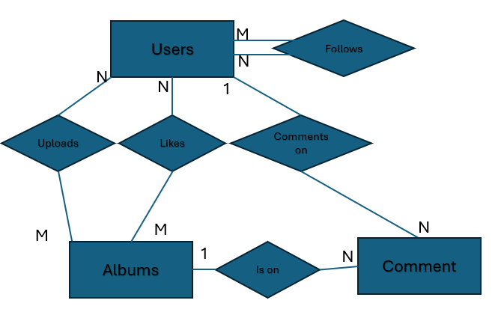
ER diagram
Users
Albums
Fields | Type
Username | Char(20)
DateCreated | Date
FavouriteAlbumId | Integer
Followers | Integer
Following | Integer
Fields | Type
Id | Integer
Title | Char(40)
Rating Score | Float
CoverArt | Image
UploaderUsername | Char(20)
UploadDate | Date
Views | Integer
Genre | Char(40) Dropdown?
1
Comments
Fields | Type
Id | Integer
Text | Char(255)
Username | Char(20)
AlbumId | Integer
Score | Integer

Slide 13
Site map
Home Page
Sign Up
Login
User Pages
About
Album Pages
Search
Delete Account
Change Password
Logout
Create Album

Slide 14
URL DESIGN
Home page - /index
About Page - /about
Sign Up - /account/register
Login - /account/login
Logout – /account/logout
Change Password - /account/password-change
Delete Account - /account/delete-account
User Pages - /user/<Users.Username>
Album Pages - /album/<Albums.AlbumTitle>
Create Album - /album/create
Search/Filter/Sort Page - /search

